Slide 1

PS-07 Innovative Monitoring System for TeleICU Patients Using Video Processing & Deep Learning
Submitted for the Intel Unnati Industrial Training Program 2024

Slide 2
PROBLEM STATEMENT Innovative Monitoring System for TeleICU Patients Using Video Processing and Deep Learning.
TeleICU is concept for monitoring ICU patients from remote locations to reduce the burden of on-site intensivist. Currently there are multiple products available in this domain where one profession seating at remote location physically monitors one or two remote patients in TeleICU. The proposed solution should work to reduce the burden of remote health care professional so, one remote health care professional can monitor 5 or more patients at single time.

Slide 3
UNIQUE IDEA BRIEF (SOLUTION)
The Advanced TeleICU Monitoring System leverages the powerful capabilities of YOLOv8 and MediaPipe to enhance patient care in intensive care units. YOLOv8 is utilized for precise person classification, providing accurate detection of patients within real-time video feeds. This ensures that the system can consistently identify and monitor patients, distinguishing them from other objects and activities within the ICU environment. Complementing this, MediaPipe is employed for detailed movement classification, using advanced pose estimation techniques to track and identify specific patient activities and patterns. This includes monitoring movements such as breathlessness, seizures and fall, which can offer crucial insights into a patient's condition. Additionally, YOLOv8's sophisticated fall detection algorithms play a critical role in patient safety by identifying falls in real-time. The system detects sudden changes in posture or rapid movements indicative of a fall, and immediately sends alerts to healthcare providers, enabling swift and effective intervention. Together, these technologies create a comprehensive monitoring solution that enhances patient safety, improves response times, and supports better overall outcomes in the ICU.

Slide 4
FEATURES OFFERED
Utilizing YOLOv8's robust object detection capabilities allows the system to accurately classify patients and distinguish them from other objects within the ICU environment. This high-precision detection ensures that the system can reliably identify patients in real-time video feeds, avoiding false positives and negatives that could arise from misidentifying medical equipment, furniture, or other personnel. By maintaining a clear focus on patient monitoring, YOLOv8 ensures continuous, accurate tracking of patient presence and activities, contributing to a more effective and responsive monitoring system.
In parallel, the development and deployment of fall detection algorithms using YOLOv8 provide a crucial layer of safety for ICU patients. These algorithms are designed to identify falls in real-time by detecting sudden changes in posture or rapid movements that are indicative of a fall.
Leverage MediaPipe's pose estimation models to track and classify patient movements, such as sitting, lying down, standing, or getting out of bed. Use MediaPipe to identify specific activities and patterns, such as restlessness, repetitive movements, or reaching for objects, providing insights into the patient's condition and comfort.

Slide 5
PROCESS FLOW
1. Dataset Collection:
We sourced a comprehensive dataset from publicly available YouTube videos relevant to ICU settings.
The videos were carefully selected to ensure diversity in scenarios and interactions typical to an ICU environment.
2. Data Preparation:
Uploaded the collected videos to Roboflow, a platform for managing and preprocessing image datasets
Annotated frames from these videos, identifying and labeling key individuals within the frames. The annotated classes include:
Patient
Nurse
Doctor
Relatives
Labelled 7100+ frames manually based on the above classes

Slide 6
3. Model Training:
Employed the YOLOv8 (You Only Look Once version 8) model for object detection.
Utilized the annotated dataset to train the YOLOv8 model.
Successfully achieved person detection within frames, with bounding boxes accurately identifying and classifying the individuals into the specified categories.
4. Model Performance:
The trained YOLOv8 model demonstrated a high level of accuracy in detecting and classifying individuals.
The bounding boxes provided reliable localization of persons within the frames, confirming the effectiveness of our annotation and training processes.
5. Movement Detection:
Develop a framework for detecting and analyzing patient movements within the video frames.
Explore motion detection algorithms and integrate them with our existing YOLOv8 model to enhance its functionality.
Evaluate the movement detection accuracy and adjust the model as necessary to ensure reliable performance.

Slide 7
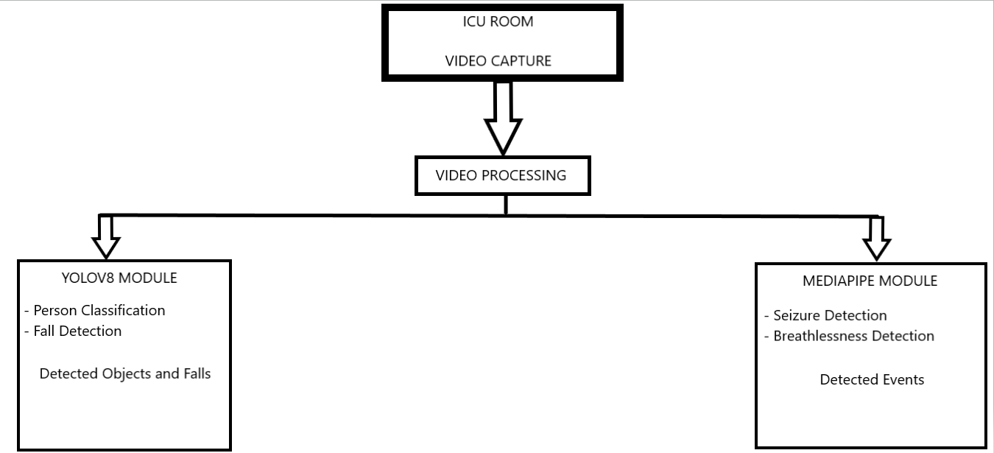
ARCHITECTURE DESIGN

Slide 8
TECHNOLOGIES USED
Roboflow Integration: Utilization of Roboflow for managing and preprocessing image datasets streamlines the data preparation process, ensuring efficiency and scalability. Frames from the videos were meticulously annotated to identify and label key individuals (Patients, Nurses, Doctors, Relatives). This detailed annotation enables the YOLOv8 model to accurately recognize and classify these individuals.
YOLOv8 for Person Classification and Fall Detection:
Framework: Deep learning framework for object detection.
Technology Stack:
Python: Programming language for implementing YOLOv8 models.
PyTorch/TensorFlow: Deep learning libraries for training and deploying YOLOv8 models.
OpenCV: Computer vision library for processing video feeds and integrating with YOLOv8.
CUDA: NVIDIA's parallel computing platform and application programming interface model for using GPU acceleration.

Slide 9
Hardware:
High-Resolution Cameras: For capturing detailed video feeds in the ICU.
GPUs (Graphics Processing Units): For accelerating the YOLOv8 model inference.
MediaPipe for Seizure and Breathlessness Detection:
Framework: Open-source framework for building multimodal (e.g., video, audio) applied machine learning pipelines.
Technology Stack:
Python/C++: Programming languages for implementing MediaPipe solutions.
TensorFlow Lite: For running inference on edge devices with MediaPipe.
OpenCV: For video processing and integrating with MediaPipe.
Google Colab: For training and prototyping MediaPipe models.
Custom Detection Algorithms:
Seizure Detection: Use MediaPipe's pose estimation and activity recognition capabilities to identify seizure-specific movement patterns.
Breathlessness Detection: Use MediaPipe's facial landmarks and respiratory motion analysis to monitor and detect abnormal breathing patterns.

Slide 10
TEAM MEMBERS & CONTRIBUTION
Team- AI Wizards
Fathima Fahim [1NT21AD018]
Manasa S [1NT21AD030]
Sneha V [1NT21AD052]
Fathima Fahim- Synopsis, Code, Dataset Creation and Final Report
Manasa S- Synopsis, Code, Dataset Creation and Final Report
Sneha V- Synopsis, Code, Dataset Creation and Final Report

Slide 11

Conclusion
The integration of YOLOv8 for person classification and fall detection, along with MediaPipe for seizure and breathlessness detection, presents a robust and innovative solution for monitoring TeleICU patients. By leveraging the precise object detection capabilities of YOLOv8, the system ensures accurate and real-time classification of patients and can swiftly identify falls, enabling immediate intervention and reducing the risk of injury. Concurrently, MediaPipe's advanced movement and pose estimation technologies allow for the effective detection of seizures and breathlessness, critical conditions that require prompt medical attention. This dual-technology approach not only enhances patient safety and care but also significantly alleviates the workload of healthcare providers by providing continuous, non-intrusive monitoring.

